Slide 1
Project 1- Maggie & Luke 10/30/2021
Ga Tech Data Science

Slide 2
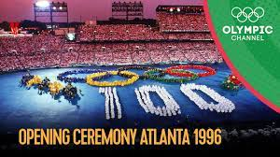
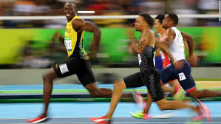
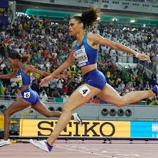
Where has all the GOLD gone…

Slide 3
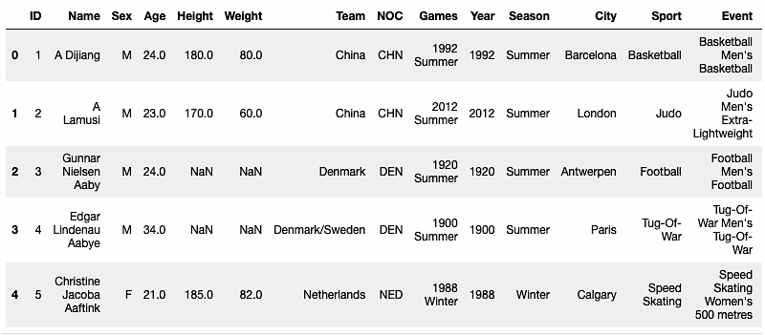
Used a combination of 3 CSV Files:
NOC
Athlete
GDP
Started with + 270K rows before cleaning.
athlete_df.isnull().values.any()
olympic_df = athlete_df.dropna()

Slide 4
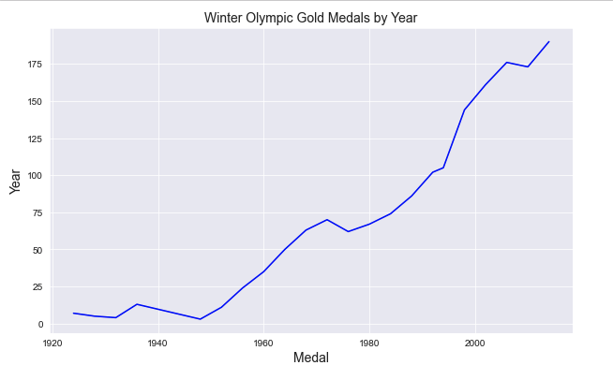
Total Number of Medals given in the Winter Olympics
1924 - 7
1972 - 70
2014 - 190

Slide 5
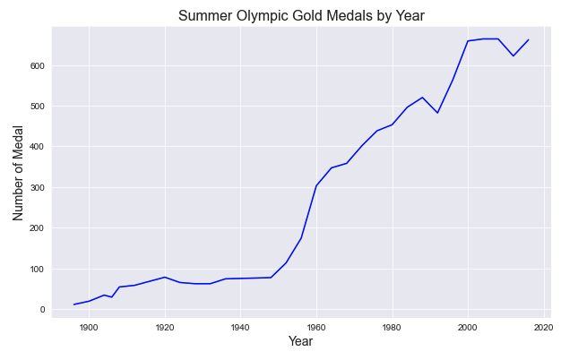
Total Number Gold Medals given in Summer Olympics
1896 - 11
1956 - 174
2016 - 662
***1960 - 303

Slide 6
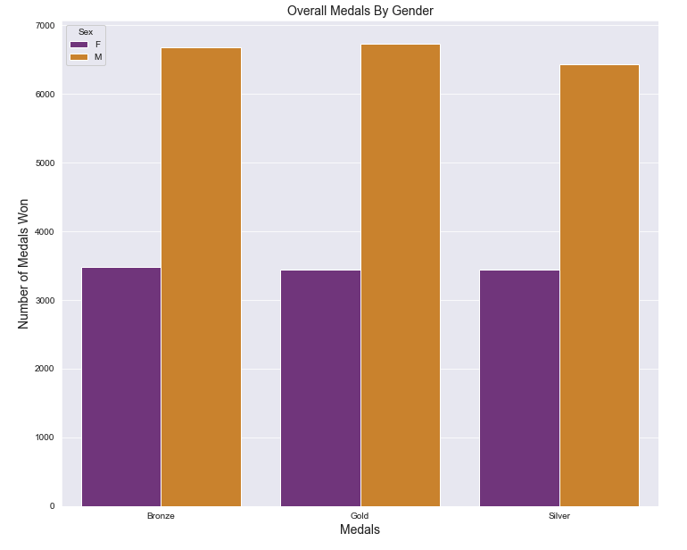
Total Medals by Gender
1896 - 2016
Females:
Gold - 3437
Silver - 3437
Bronze - 3435
Males:
Gold - 6770
Silver - 6328
Bronze - 6603

Slide 7
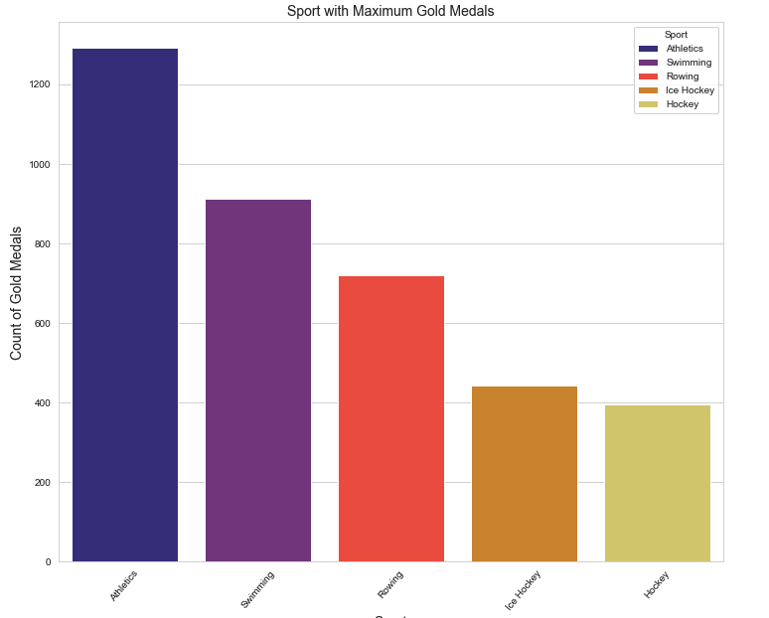
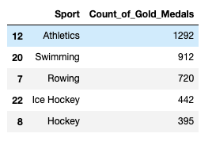


Slide 8
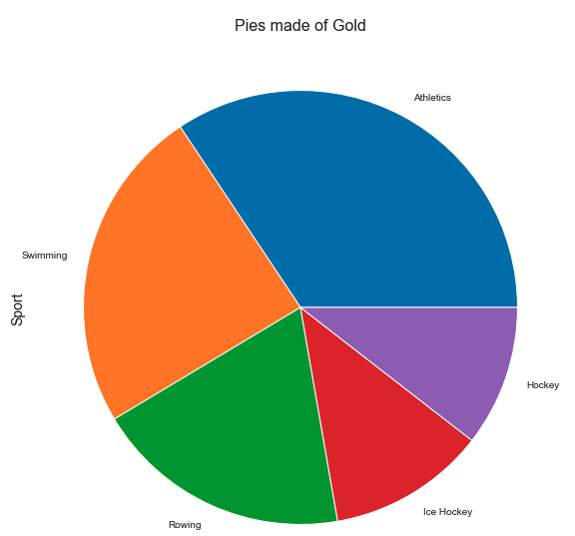
Have some Pie!
Rowing???

Slide 9
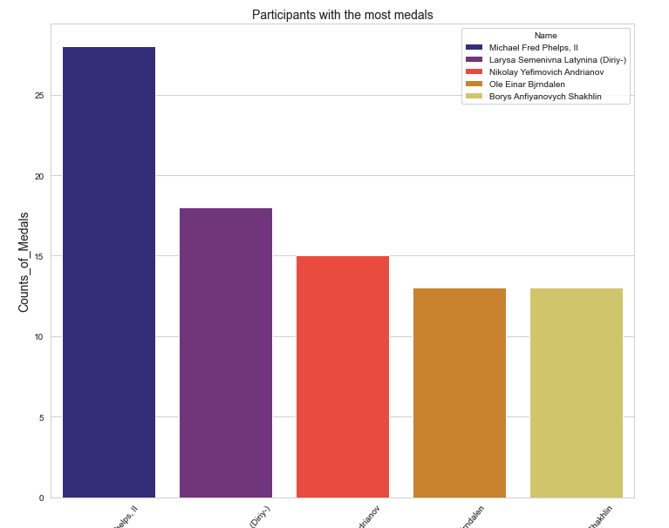
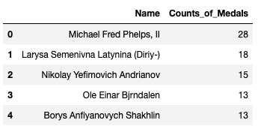

Slide 10
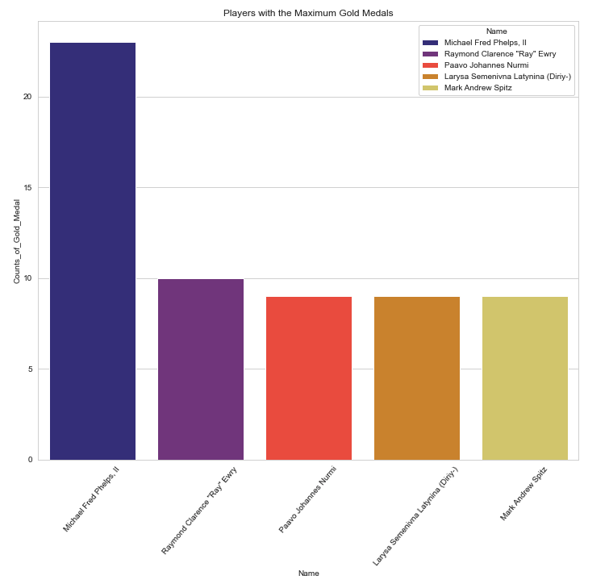
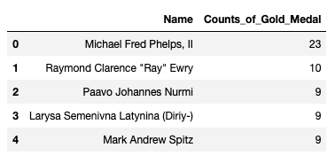

Slide 11
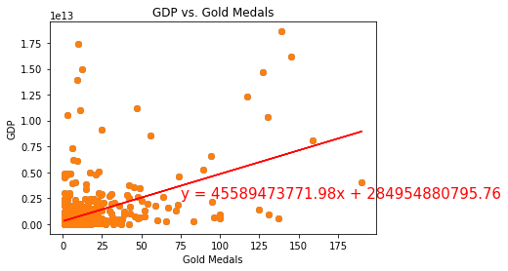
GDP vs. Number of Gold Medals (r-value: 0.48)

Slide 12
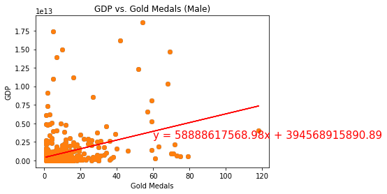
GDP vs. Number of Gold Medals [Male]
(r-value: 0.36)

Slide 13
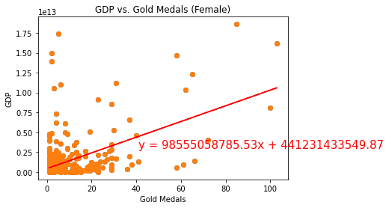
GDP vs. Number of Gold Medals [Female]
(r-value: 0.52)

Slide 14
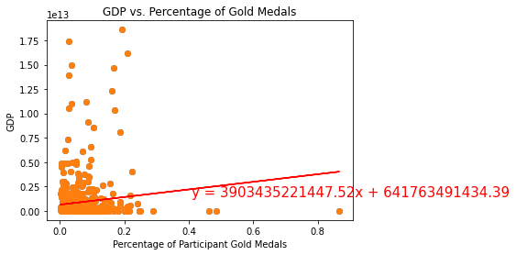
GDP vs. Percentage of Gold Medals
(r-value: 0.12)

Slide 15
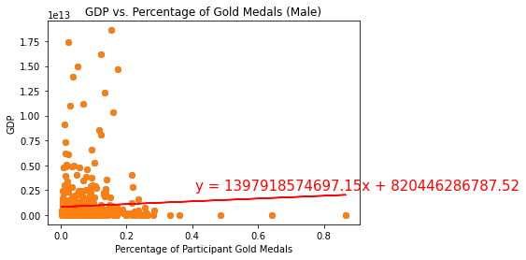
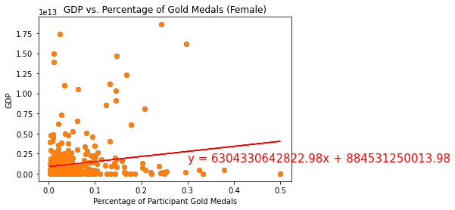
GDP vs. Percentage of Gold Medals [Male]
(r-value: 0.05)
[Female]
(r-value: 0.17)

Slide 16
Calculating T-statistics
Population = Percentage of Gold Medals Overall
Sample = Percentage of Gold Medals from Male Athletes
Ttest_1sampResult(statistic=-1.7251401541630382, pvalue=0.09992250188053525)
Population = Percentage of Gold Medals Overall
Sample = Percentage of Gold Medals from Female Athletes
Ttest_1sampResult(statistic=2.2433708531343024, pvalue=0.036355965634313515)

Slide 17
Conclusions
Based on our analysis, we conclude that it may be worth investing more in the recruitment and support of female athletes who aspire to one day compete in the Olympics.

